Slide 1



BANK LOAN CASE STUDY
By : AFZAL ALAM

Slide 2

INDEX:
PROJECT DESCRIPTION
DATASET
APPROACH
TECH –USED
INSIGHTS
CONCLUSION
RESULTS

Slide 3

PROJECT DESCRIPTION
In this project, we aim to analyze a loan application dataset to gain insights into factors influencing loan defaults.
Our goal is to handle missing data, identify outliers, analyze data imbalance, and perform various statistical analyses.
Accurate handling of data is crucial for ensuring the reliability of our analysis.
Since some costumers don’t have sufficient credit history, they default on their loans. I was provided with a dataset and my task was to use Exploratory Data Analysis (EDA) to analyze patterns in the data and ensure that capable applicants are not rejected.

Slide 4

DATA SET:
BANK LOAN SOLUTION EXCEL SHEET

Slide 5

APPROACH
I have followed a systematic approach to analyze the loan application dataset.
Done Data preprocessing and cleaning to ensure accuracy
Explore and understand the loan application dataset and dela with missing data
Analyze data imbalance to address issues in binary classification

Slide 6


TECH STACK USED
For this project, I utilized Excel software along with charts, and macros. Excel's pivot tables allowed me to efficiently analyze and summarize data, while the charts helped in visually representing the information. The combination of these tools in Excel proved to be instrumental in conducting data analysis and presenting the findings effectively.

Slide 7

INSIGHTS
Data Analytics Tasks
IDENTIFY MISSING DATA AND DEAL WITH IT APPROPRIATELY
IDENTIFY OUTLIERS IN THE DATASET
ANALYSE DATA IMBALANCE
PERFORM UNIVARIATE, SEGMENTED UNIVARIATE, AND BIVARIATE ANALYSIS
IDENTIFY TOP CORRELATIONS FOR DIFFERENT SCENARIOS

Slide 8

A. Identify Missing Data & Deal with it appropriately. Task: Identify missing data in the dataset and decide on an appropriate method to deal with it using Excel built-in functions and features
INSIGHTS:
Initially there were 123 columns and 50000 rows in the data. To deal with missing data I firstly calculate null values percentage on the basis of that I removed the column having null value percentage greater than 30%, also there were some undesirable columns, so I delete those columns too. Then for the remaining columns I used median method to fill missing values for numerical columns.

Slide 9

INSIGHTS: A

Slide 10
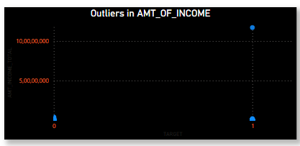
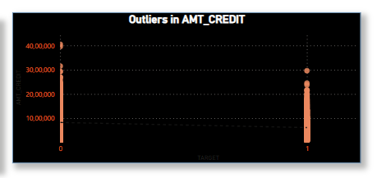
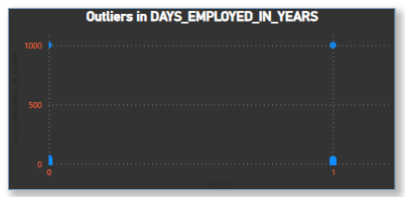
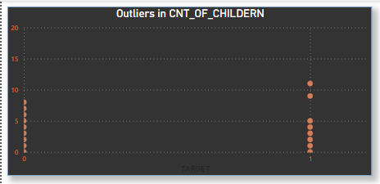
B. Identify Outliers in the Dataset Task: Detect and identify outliers in the dataset using excel statistical functions and features, focusing on numerical variables
INSIGHTS: B
Box plotted Target Column
AMT_OF_ INCOME
AMT_CREDIT
DAYS_EMPLOYED_IN_YEARS
CNT_Of_Children

Slide 11
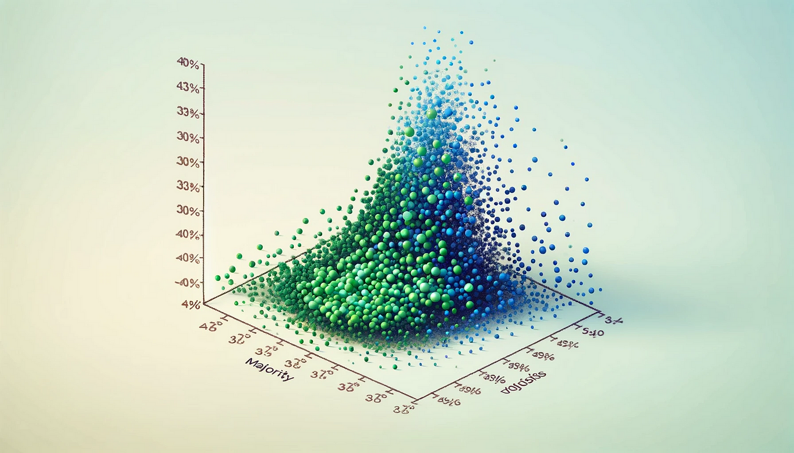
C. Analyse Data Imbalance: Task: Determine if there is data imbalance in the loan application and calculate ratio of data imbalance using excel function
INSIGHTS: C
Data imbalance can affect the accuracy of the analysis, hugely.
In the given dataset the TARGET feature was the choice for calculating the Data imbalance since this feature actually identifies the basic information on customers(0 for customers who are not defaulters in payment and 1 for the customers who were defaulters in payment)
A pivot table of the TARGET feature was created and then the counts of both the values(0 and 1) were calculated followed by the Pie-chart.
Out of 49999 values, only 4026 values are 1 and others are 0.
Feature | Count of TARGET
0 | 45973
1 | 4026
(blank)
Grand Total | 49999

Slide 12
D. Perform Univariate, Segmented Univariate and Bivariate Analysis : Task: Perform univariate analysis to understand distribution of individual variables. Segmented univariate analysis to compare variable distributions for different scenarios, and bivariate analysis to explore relationship between variables and target variable.
INSIGHTS: D
To gain insights into the driving factors of loan default, it is important to conduct various analyses on consumer and loan attributes.
On targets, I have Performed univariate analysis to understand variable distributions.
Utilized segmentation for comparing variable distributions in different scenarios.
Presented results using insightful
Column charts ,Line charts and PIE charts
I have done Univariate and segmented analysis on Features:
Age(bins) and Segmented age(The count of targets in percentage)
Years employed and segmented Years Employed
Code of gender and segmented Count of gender
Name type suite vs Segmented name type suite
Education type vs segmented education type
Occupation type and occupation type segmented

Slide 13
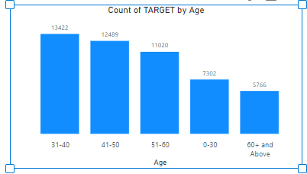
Univariate & Segmented Univariate
INSIGHTS: D
The maximum number of customers take loan reside in the age range of 31-40
The highest number of defaulters:31-40. The lowest number of defaulters: 60+ and above

Slide 14
Univariate & Segmented Univariate
INSIGHTS: D
The maximum number of customers who take loans reside in 0-9 years of experience
The highest number of defaulters:0-9
years
The lowest number of defaulters: 30-39 years.

Slide 15
Univariate & Segmented Univariate
INSIGHTS: D
The Number of female customer is much more than other genders
Female customer have more numbers of defaulter compared to other genders

Slide 16

Univariate & Segmented Univariate
INSIGHTS: D
Most customers were unaccompanied at the time of issuing loans to themselves from the bank
Maximum number of defaulters:
Unaccompanied people
The minimum number of defaulters:
Customers with spouses, and partners.
Most of customers completed
their secondary/special secondary
examination at the time of issuing loans to themselves from the bank.

Slide 17

INSIGHTS: D
Univariate & Segmented Univariate
The maximum number of defaulters: People with academic degrees.
The minimum number of defaulters: Customers with secondary/special secondary degrees.
The majority of customers were from business entity-3 at the time of issuing loans to themselves from the bank
Maximum number of defaulters:
Business entity-3
The minimum number of defaulters: Business entity -1.

Slide 18
Bivariate Analysis
INSIGHTS: D
From the bivariate analysis, it is seen that customers in the age range of 41-50 have credited the highest amount of average credit.
From the bivariate analysis, it is seen that customers who were businessmen, under maternity, and students were no defaulters whereas unemployed customers were t₂h₁ e highest number of defaulters.

Slide 19
E. Identify top correlation for different scenarios: Task: to determine top correlation for each segmented data(client with payment difficulties and all other cases.
B
B
Understanding the correlation between variables and the target variable can provide insights into strong indicators of loan default.
In this project i have segmented the dataset to find top correlations between variables and the target variable.
Calculated correlation coefficients using excel functions.
Highlighted top 10 correlations with correlation matrices.
I HAVE EXECUTED CORRELATION ANALYSIS ON FEATURES:
YEARS OF EXPERIENCE WITH FLAG_EMP_PHONE
OBS_30_CNT_SOCIAL_CIRCLE WITH OBS_60_CNT_SOCIAL_CIRCLE
AMT_CREDIT WITH AMT_GOODS_PRICE
REGION_RATING_CLIENT WITH REGION_RATING_CLIENT_WITH_CITY
CNT_CHILDERN WITH CNT_FAMILY_MEMBERS
REG_REGION_NOT_WORK_REGION WITH
LIVE_REGION_NOT_WORK_REGION
DEF_30_CNT_SOCIAL_CIRCLE WITH DEF_60_CNT_SOCIAL_CIRCLE
1. I have used excel’ s data analysis feature to find correlation matrices.
2. The formula used to find the correlation for the specific features:
=Correl(sheet1!L2:l4027,she et1!Q2:q4027
19

Slide 20

The correlations-Top 10 values
1. Years of experience- FLAG_EMP_PHONE :
-0.999899227065333 2.OBS_30_CNT_SOCIAL_CIRCLE-
OBS_60_CNT_SOCIAL_CIRCLE:
0.998064837349622
AMT_CREDIT-AMT_GOODS_PRICE:
0.982432317758075
REGION_RATING_CLIENT- REGION_RATING_CLIENT_WITH_CITY:
0.950768898851766
CNT_CHILDERN - CNT_FAMILY_MEMBERS: 0.892521874588344
REG_REGION_NOT_WORK_REGION- LIVE_REGION_NOT_WORK_REGION:
0.806743885821316
DEF_30_CNT_SOCIAL_CIRCLE- DEF_60_CNT_SOCIAL_CIRCLE:
0.890496347984347
REG_CITY_NOT_WORK_CITY-
LIVE_CITY_NOT_WORK_CITY;
0.783754676418725
AMT_ANNUITY-AMT_GOODS_PRICE:
0.749705184075139
AMT_CREDIT-AMT_ANNUITY:
0.749665201431795

Slide 21
TOP 5 CORRELATIONS FOR CLIENT WITH PAYMENT DIFFICULTIES
AMT_CREDIT | AMT_GOODS_PRICE | 0.982268
REGION_RATING_CLIENT _W_CITY | REGION_RATING_CLIENT | 0.950769
AMT_ANNUITY | AMT_CREDIT | 0.749665
AMT_GOODS_PRICE | AMT_ANNUITY | 0.749504
DAYS_EMPLOYED(YEAR) | DAYS_BIRTH(YEAR) | 0.587858

Slide 22

CONCLUSIONS:
The bank needs to address outliers and payment difficulties to minimize risks associated with defaulting clients.
The imbalanced dataset necessitates the use of appropriate techniques to handle class imbalance during modeling.
The bank's preference for granting loans to comparatively senior clients seems reasonable due to potential stability in financial backgrounds, resulting in the chart.
Clients with limited employment experience may require closer scrutiny during loan approval.
Further investigation is needed to understand why male clients show slightly higher default rates when compared with the total number of loans taken.
Focusing on clients with secondary education might be beneficial as they form the largest customer segment.
Business Entity Type 3 clients may require special attention due to their high loan uptake.

Slide 23


Being a statistical and pure Data Analysis project, this has helped me a lot in learning and applying, there are a few areas I have learned to work on,
Thorough Analysis: As the first step, I have explored loan data for default insights.
Effective Data Handling: Learned to manage missing values and outliers.
Balanced Analysis: Got familiar with addressing data imbalance for classification.
Strong Correlations: Got familiar with correlation methods and how to identify the key indicators for defaults.
Impactful Visualization: Learned to create clear charts for better understanding, especially for complicated calculations.
Tech Expertise: Added proficiency in Excel, PowerPoint
Business Optimization: Learned to deal with, work with, and Analyze real-world complex data for further improvements.

Slide 24


